Slide 1
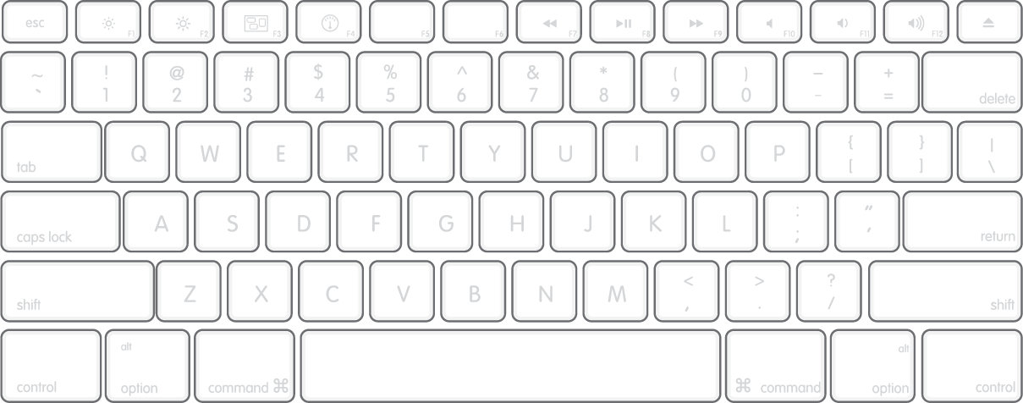
Note: bindings marked in parentheses are used with the shift key
Best parameters:
- mix cue 0%
- cue vol up
- gain –
- tick ON
BEATGRID HELPER:
Next+L
(Prev)
Set1
(Del1)
Set2 (Del2)
Set3
(Del3)
Set4
(Del4)
Play/ Pause
Cue
Lock
Zo ++
(<<-)
Zo --
(|)
Zoom ||s
Tick
(Auto)
Seek
<<-
Seek
<-
Seek
->
Seek
|
Grid <-
(<<-)
Grid ->
(->>)
Set
(Del)
BPM <-
(<<-)
BPM ->
(->>)
Play
Pause
Jump
A+B <-
Jump
A+B ->

Slide 2
